Slide 1
Kaggle训练营

Slide 2
Feature Engineering
Feature Simplification
Combine Features:
X_new=X1 * X2
Box-Cox Transformation (log transformation is one of the family)
Stabilize data variance
Make data close to normal distribution
Improve correlation
X_new=X^(n); n=-1, -2, 0.5, 1, 2, 3……

Slide 3
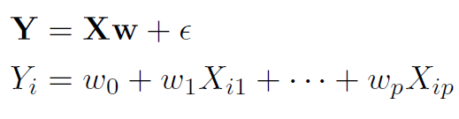
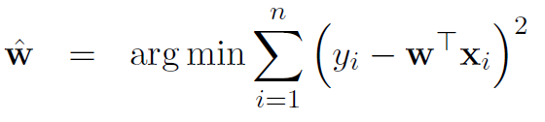

Multivariate Regression
Model:
OLS minimization Target:
Result:

Slide 4

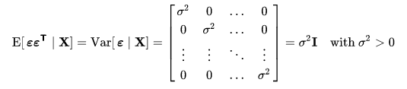
Linear Regression 5 Assumptions
Gauss-Markov Theorem: Best Linear Unbiased Estimator (BLUE)
The least variance unbiased linear estimator
Lineararity: The relationship between X and Y is linear, If true form between X and Y is Y=Beta * X
Exogeneity: Expectation of error terms conditional on the independent variables are zero
Homoscedasiticy (Constant of Variance): variance of error terms is the same
Lack of perfect multicollinearity: Rank(X)=k, full column rank
Another Assumptions: Normality of error distribution

Slide 5

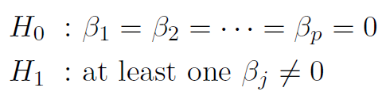
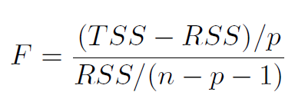
How to measure the fitness of a regression
Adjusted R Squared:
P-value of F-stats:
P-value of T-stats of individual variables
Question: relationship between T-test and F-test for simple regression model

Slide 6
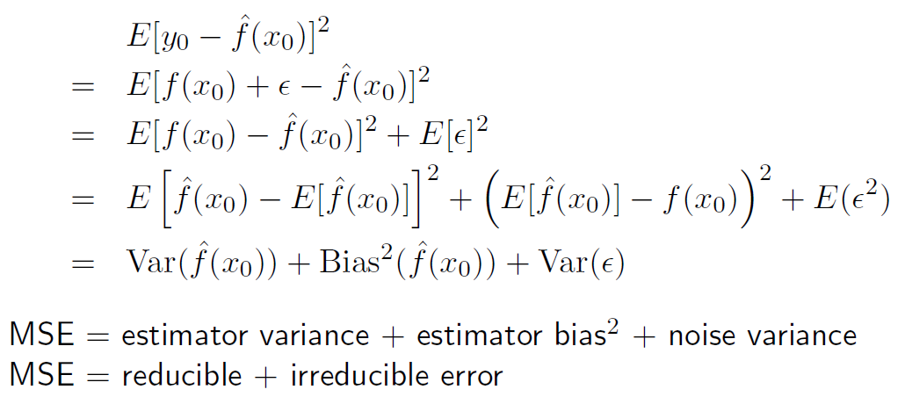
Next Questions
Why not keep adding variables? – Key problem of machine learning!
Bias – Variance Tradeoff
Decompose Mean Squared Error

Slide 7
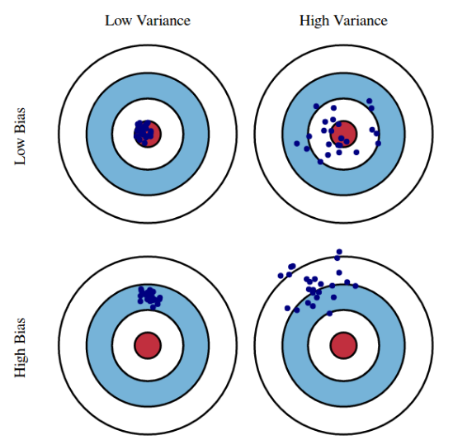
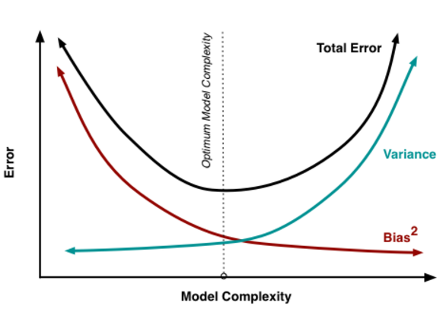
Bias-Variance Tradeoff
Bias: error caused by difference between expected estimator and true function
Variance: this is a measure of estimator spread... that is, how much does the estimator vary with a new data set

